Slide 1

Machine Learning Approach to Measure Player Performance
A Machine learning and Artificial Intelligence project
Group 7
19CCE213 – Machine Learning & Artificial Intelligence

Slide 2
G-7 Group members
Ambareesh - [CB.EN.U4CCE20006]
Aravind Ragav B R - [CB.EN.U4CCE20008]
Krish Mehta - [CB.EN.U4CCE20029]
P G Mukund - [CB.EN.U4CCE20034]

Slide 3
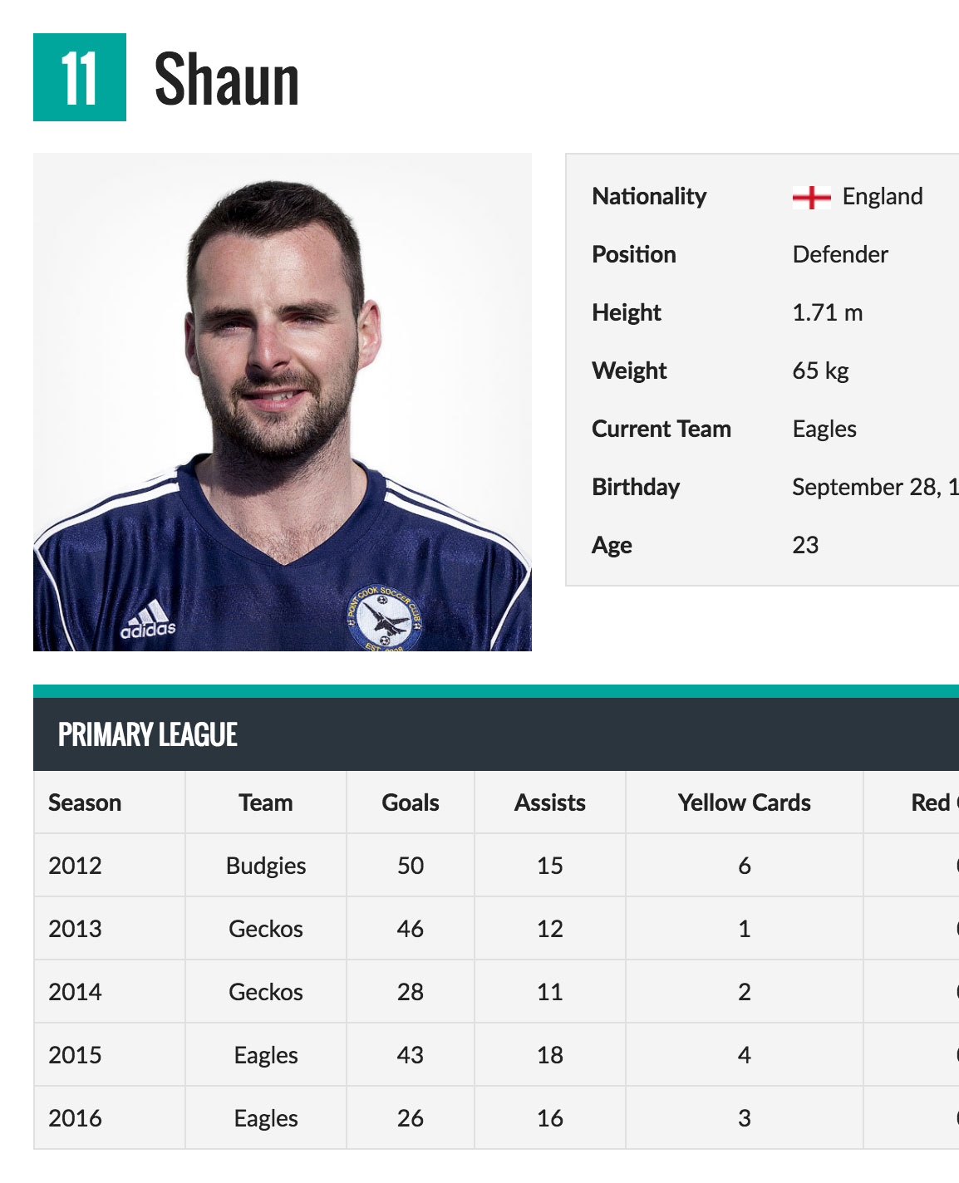
objective:
Soccer is and has been one of the most important games in the world.
And many premier leagues have led to the development of many soccer clubs all over the world.
Creating new clubs with young players, loaning players from other clubs, picking choice positions, determining wages and remuneration to players based on performance and international rankings is complicated decision process in terms of global business perspective.
This project presents a data science approach to minimize the time taken in selecting a player for a team by considering the cost and player’s skills as constraints.

Slide 4
Motivation
Soccer is a well – known game all around the world and we the fans of the game have been keenly following how clubs select their players for their club to play in a league. This keen interest of ours had led us to try providing a solution to make the recruitment process of the players efficient using concepts of machine learning.

Slide 5
Methodology
Data Source
Exploratory Data Analysis
Dimensionality Reduction
Predicted Output
Model Building

Slide 6
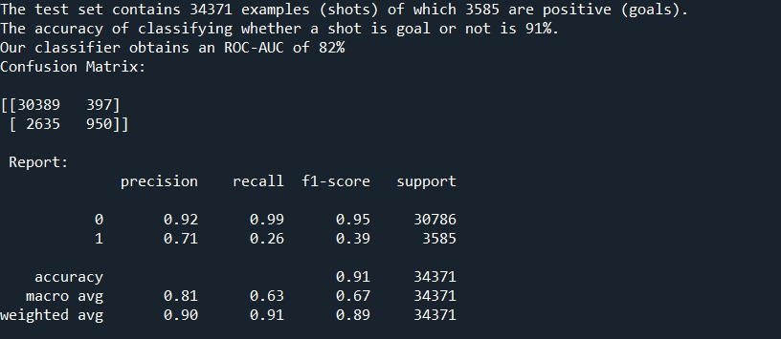
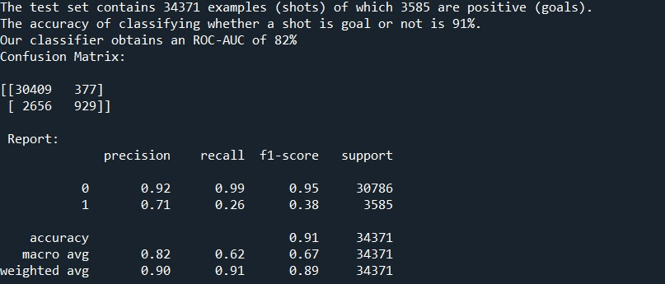
SIMULATION RESULTS

Slide 7
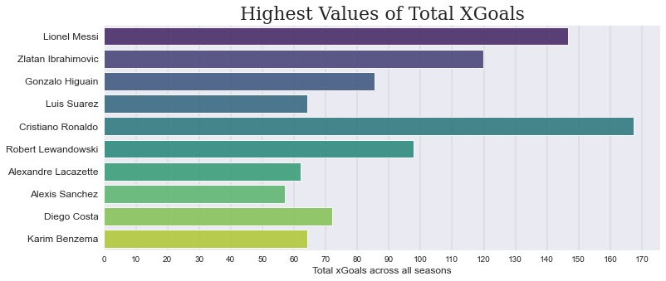
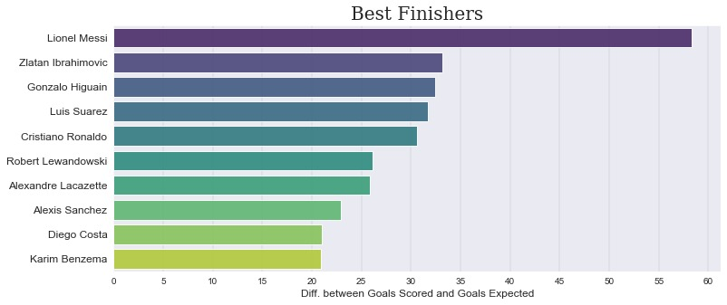

Slide 8
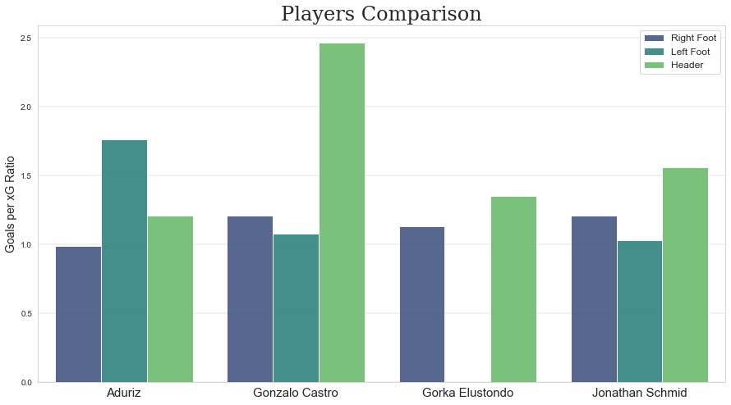
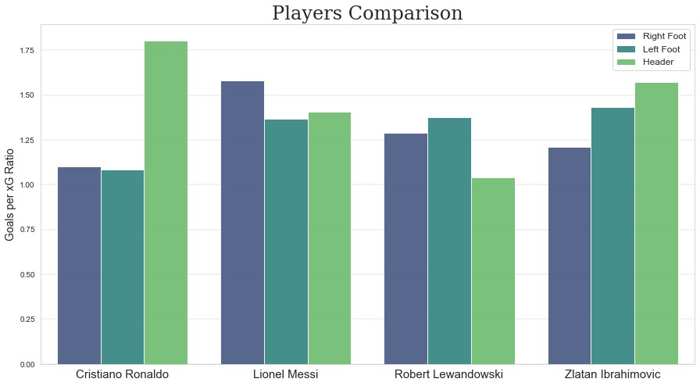

Slide 9
references
[1] Player Performance Prediction in Football Game - Richard Pariath,Shailin Shah,Aditya Surve,Jayashri Mittal [ (ICECA 2018)
[IEEE Conference Record # 42487]
[2] R. Stanojevic and L. Gyarmati, "Towards Data-Driven Football Player Assessment", 2016 IEEE 16th International Conference on Data Mining Workshops (ICDMW), pp. 167-172, 2016.

